Slide 1
Geometry - Boxes and Cubes
Programming – Maths for Games

Slide 2
Contents
Definition of Boxes
Axis Aligned Bounding Boxes
AABB vs Point Tests
AABB vs AABB Tests
Oriented Bounding Boxes
OBB vs Point Tests

Slide 3
Definition
A Box is a rectangular shape consisting of:
4-sides in 2D
6-sides in 3D
Typically has width, height and depth
In games they are typically represented in one of two ways
Axis-Aligned Bounding Boxes (AABB)
Un-rotated
Oriented Bounding Boxes (OBB)
Can be rotated to any orientation
AABB
OBB

Slide 4
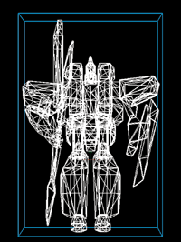
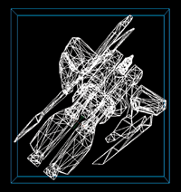

Axis-Aligned Bounding Boxes
AABB’s represent an un-rotated box
If used to bound a complex object, regardless of the object’s orientation the box is aligned to the global axis
Typically represented in two ways:
Minimum and Maximum corner points
Position and Half-Extents
Position is at the centre of the box
Half-extents represent the half-width, half-height, half-depth of the box in each axis, usually represented as a single Vector storing each extent within the X, Y and Z
Can easily switch between the two representations
$min=position−halfExtents$
$max=position+halfExtents$
max
min
half-height
half-width
position

Slide 5
Building an AABB from Points
AABBs can be created explicitly, or generated automatically
The pseudocode to the right would build an AABB from a collection of points
We can also enlarge an AABB to fit other points or AABB’s in a similar manner
Simply expand the min or max to fit the new points or object
set min to large number
set max to –min
for p in points
if p less than min
set min to p
if p greater than max
set max to p
max
Expand to fit
min

Slide 6
AABB vs Point Tests
We can use an AABB for various geometry intersection tests
A simple test is against a Point
Is the point inside the box or outside the box?
We can simply test if the point is within the range of the Minimum and Maximum corner pointers
max
point
min
$$overlap=point≥min \&\& point≤max$$
$$noOverlap=point<min\text{ || }point >max$$

Slide 7

AABB vs AABB
max1
We can also test if an AABB overlaps another AABB
For ANY axis, if the min and max values along that axis don’t overlap the corresponding axis of the second box, then there is no overlap
If ALL axes overlap then the boxes are overlapping
For example:
o$verlap=$
${max2}_{x}≥{min1}_{x} \&\&{ max2}_{y}≥{min1}_{y} \&\&$
${min2}_{x}≤{max1}_{x} \&\& {min2}_{y}≤{max1}_{y}$
min1
No Overlap in Y-Axis
max2
min2
Overlap in X-Axis

Slide 8
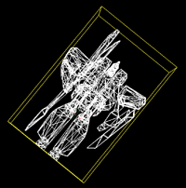

Oriented Bounding Boxes
Sometimes we do want a box to rotate with an object it bounds
Tighter fit in some instances
An OBB is typically represented by:
Position at the centre of the box
Half-extents in each axis, as separate Vectors, that can be rotated
This representation almost matches a Transform Matrix
Storing each axis of rotation, and a translation element
$$\left[\begin{matrix}X_{x} & Y_{x} & T_{x} \\ X_{y} & Y_{y} & T_{y}\end{matrix}\right]$$
The two axes store the half-extents and their orientation

Slide 9
Oriented Bounding Boxes
Generating an OBB from a collection of points is not a simple task
There are various methods that are beyond the capabilities of this session
They typically involve finding the centre of the box, then determining the extents and orientation using various algorithms
However, we can fairly easily perform an OBB vs Point overlap test
OBB vs OBB overlap tests are more complex and can be implemented with the Separating Axis Theorem mentioned in a later session

Slide 10

OBB vs Point
We can test a Point with an OBB
First calculating the vector between them
Simply subtract the point from the centre
$$V=point−centre$$
point
V
centre

Slide 11
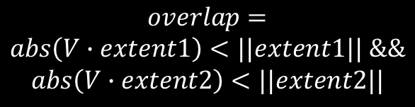
OBB vs Point
Then perform Dot Product between the Vector against each axis of the extents
If the absolute of the result is greater than the axis’ magnitude then there is no overlap
$$overlap=$$
$$abs\left(V∙extent1\right)<\text{||}extent1|| \&\&$$
$$abs\left(V∙extent2\right)<\text{||}extent2\text{||}$$

Slide 12
Summary
Bounding Boxes are one of the simplest forms of Bounding Volumes
Axis-Aligned Bounding Boxes (AABB) are easily computed and tested against Points and other AABBs
Oriented Bounding Boxes (OBB) are more complex to calculate and use
We can test them against points using Dot Products

Slide 13
Further Reading
Dunn, F, Parberry, I, 2011, 3D Math Primer For Graphics And Game Development, 2nd Edition, CRC Press
Lengyel, E, 2012, Mathematics for 3D Game Programming and Computer Graphics, 3rd Edition, CENGAGE Learning

